Slide 1
Ethernet setting

Slide 2
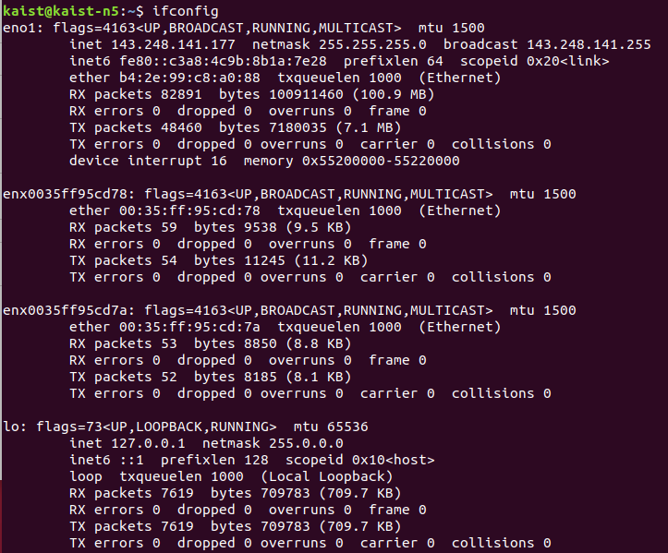
Connect BBB to PC
After connecting BBB (please refer to TA presentation slides),
type “ifconfig” in a terminal
somehow connected
but IP is not defined

Slide 3
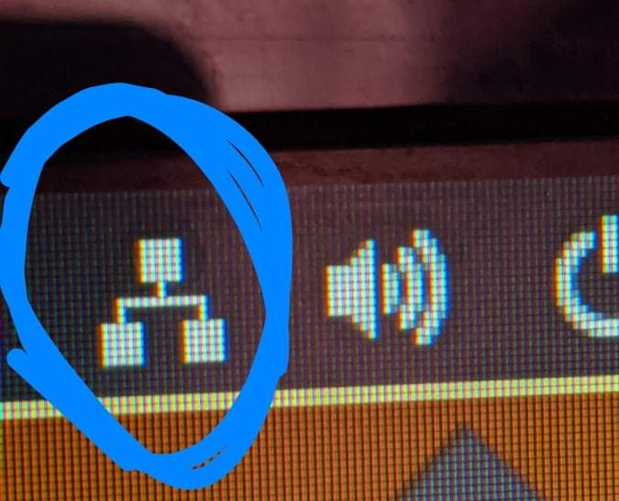
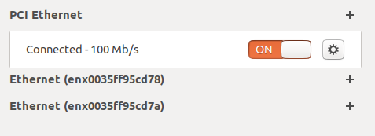
2. go to Ethernet setting
Click icon on the upper right corner
or Settings-Network
somehow connected
but IP is not defined

Slide 4
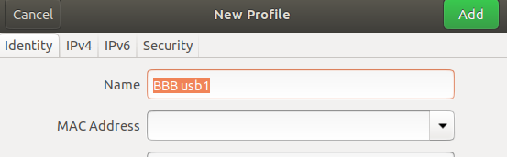
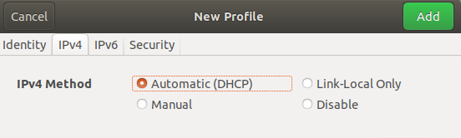
3. add new profile
Add new profile with click “+” Name : BBB usb1 IPv4 method : check Automatic (DHCP)
Then, click Add button
Make one more profile named “BBB usb2” with same setting.

Slide 5
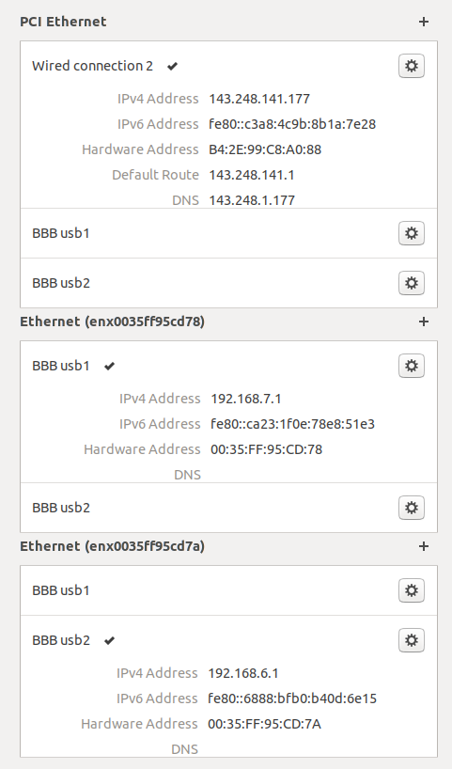
4. Assign each setting to its corresponding network
Internet: original setting (fixed IP setting)
click
Network1(BBB1): Automatic (DHCP)
click
Network2(BBB2): Automatic (DHCP)
click

Slide 6
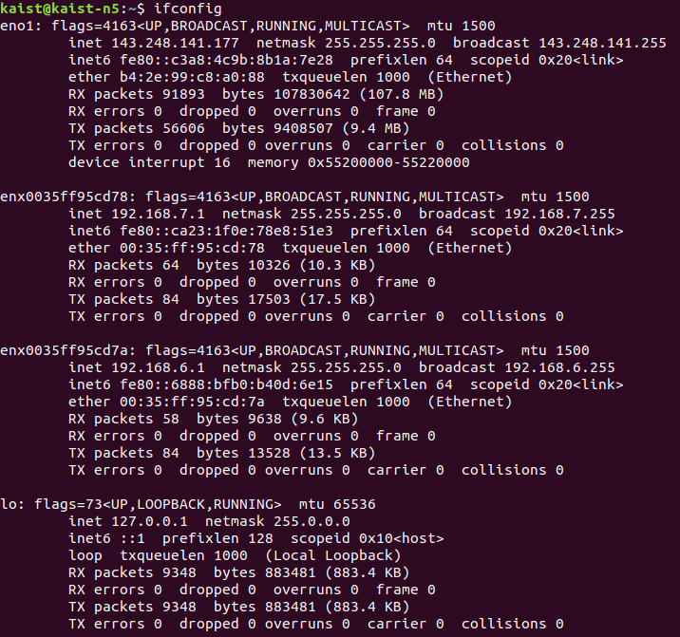
Result
IP for internet
IPs for local network(PC-BBB) are assigned correctly

